Slide 1
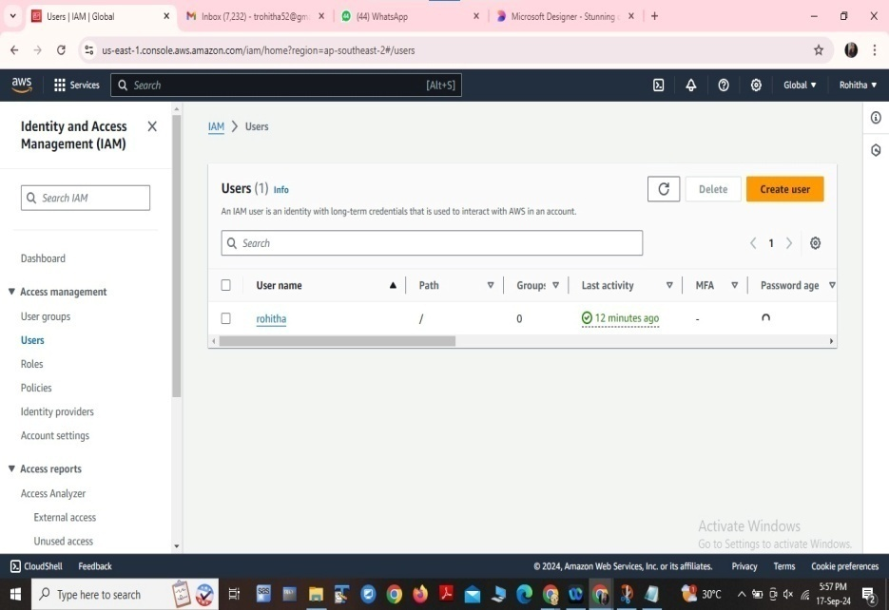
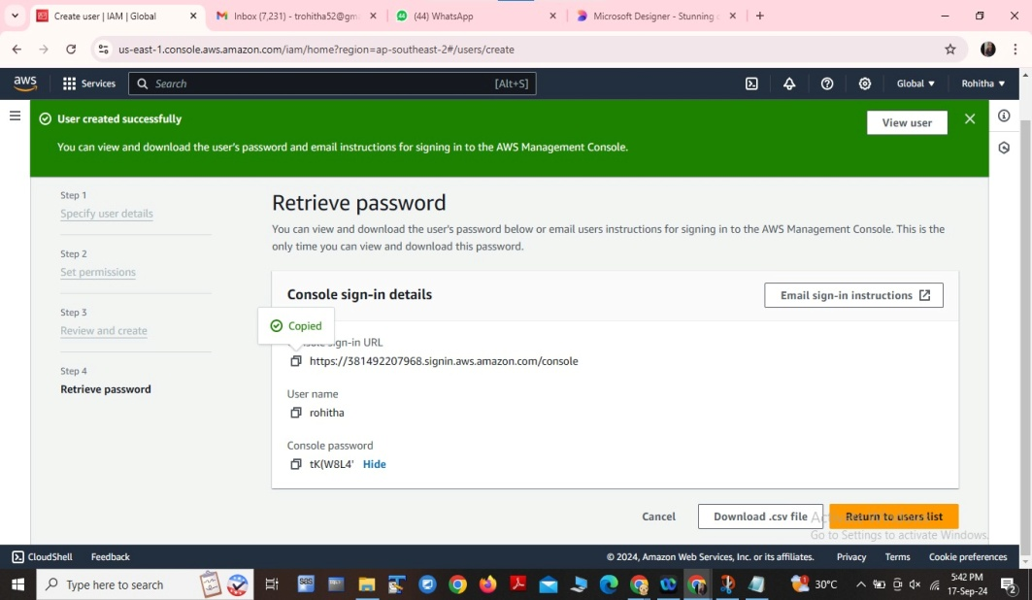
Identify and Access Management
1. Create an IAM user and specify the user details.
2. Assign necessary permissions to the user.
3. Review the user details and confirm creation.
4. Obtain the console URL and temporary password.
5. Copy the URL, open it in a browser ( Cognito tab), and enter the username and temporary password.
6. Set a new password to complete the user setup.

Slide 2
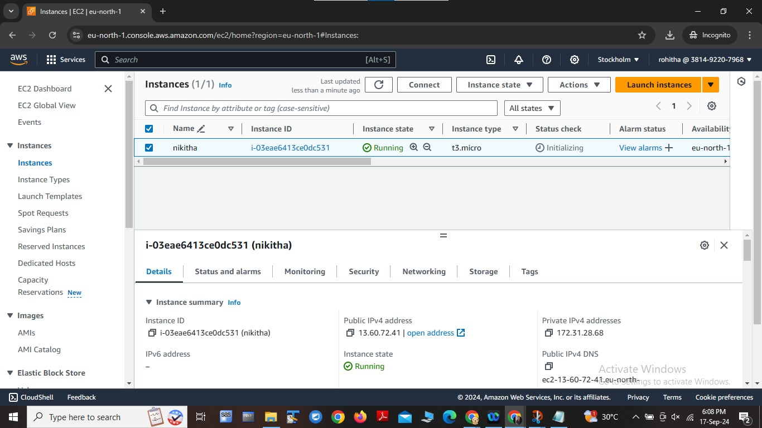
To set-up a Jenkin’s Instance
1. Create an instance in your cloud platform.
2. Run Jenkins using Git Bash.
3. Edit the inbound rules to allow necessary traffic.
4. Copy the IPv4 DNS address.
5. Open the DNS address in a new tab to access the Jenkins dashboard.

Slide 3
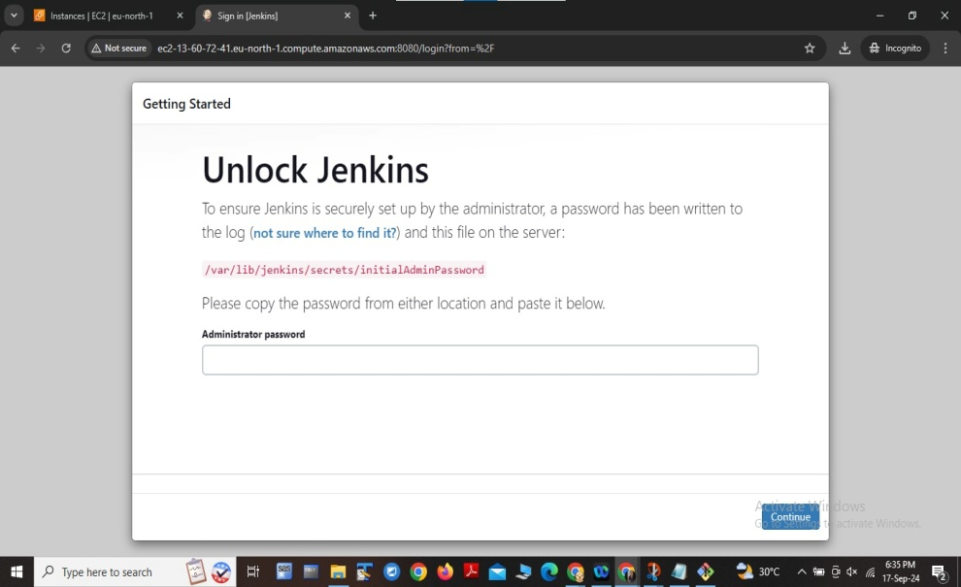
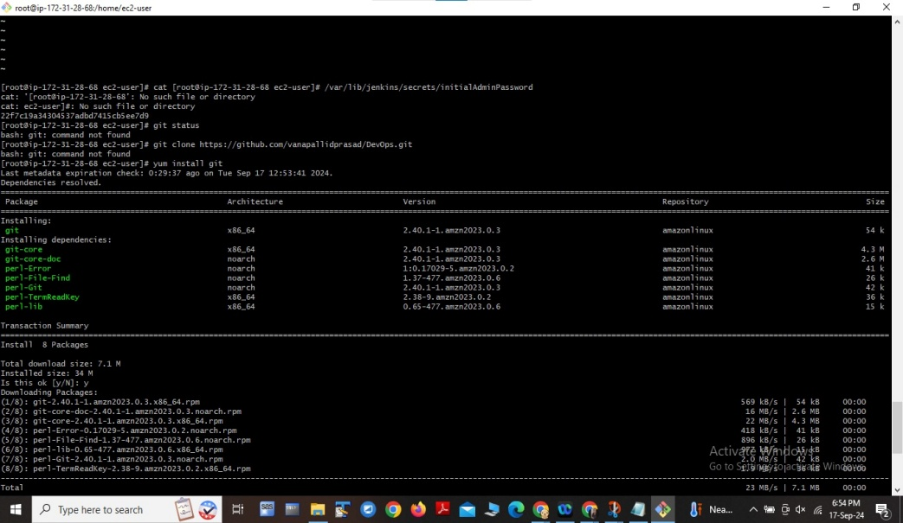
Unlock Jenkins:
1. Paste the Jenkins URL in Git Bash to obtain the unlock password.
2. Copy the password from the console output.
3. Use the password to unlock Jenkins.
Install Git and Clone Repository:
1. Install Git on your system.
2. Open Git Bash and navigate to your desired directory.
3. Clone the GitHub repository using: git clone
4. repository_URL.

Slide 4
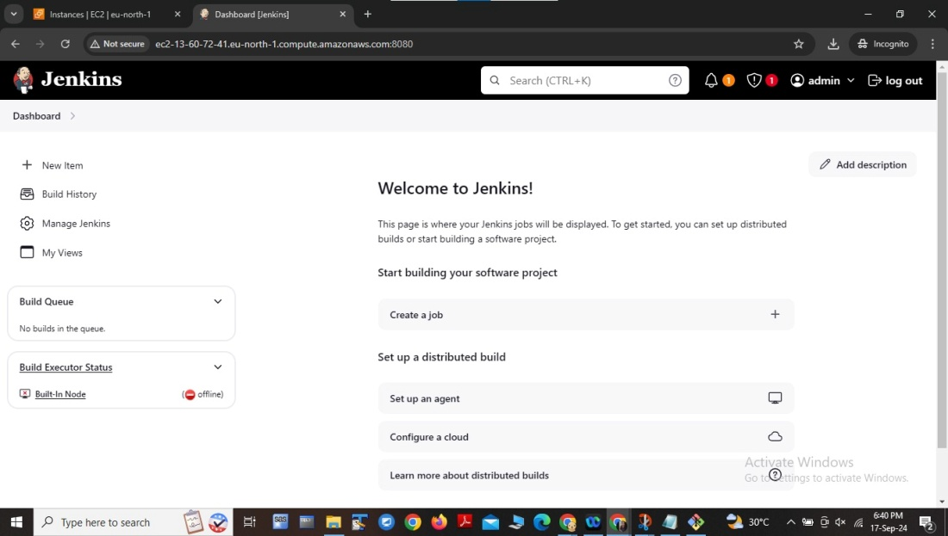
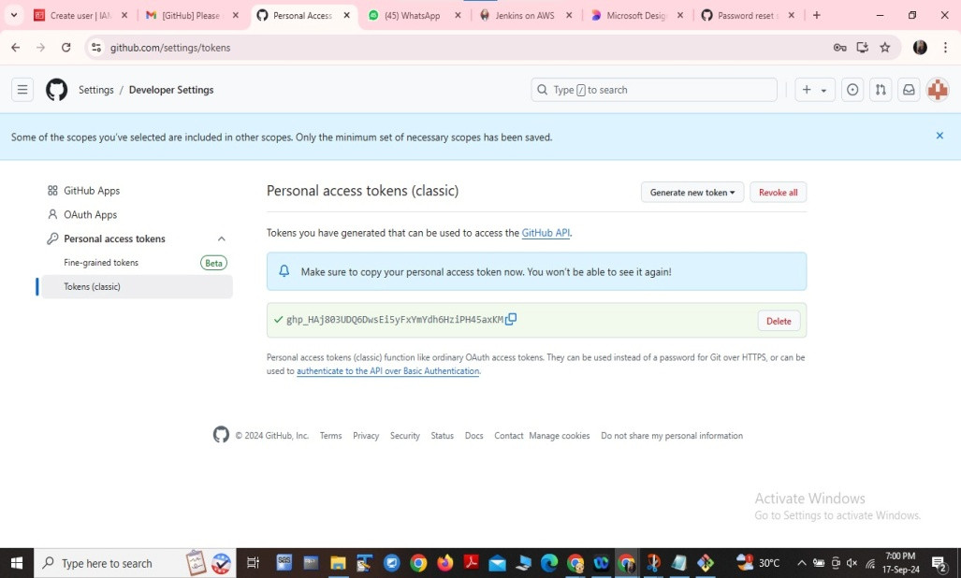
Convert to DevOps:
1. Switch from user to DevOps mode in git bash.
2. Make changes to the repository.
Configure Git Settings and Generate Personal Access Token:
1. Change developer settings in Git.
2. Generate a Personal Access Token (PAT).
3. Copy the PAT

Slide 5
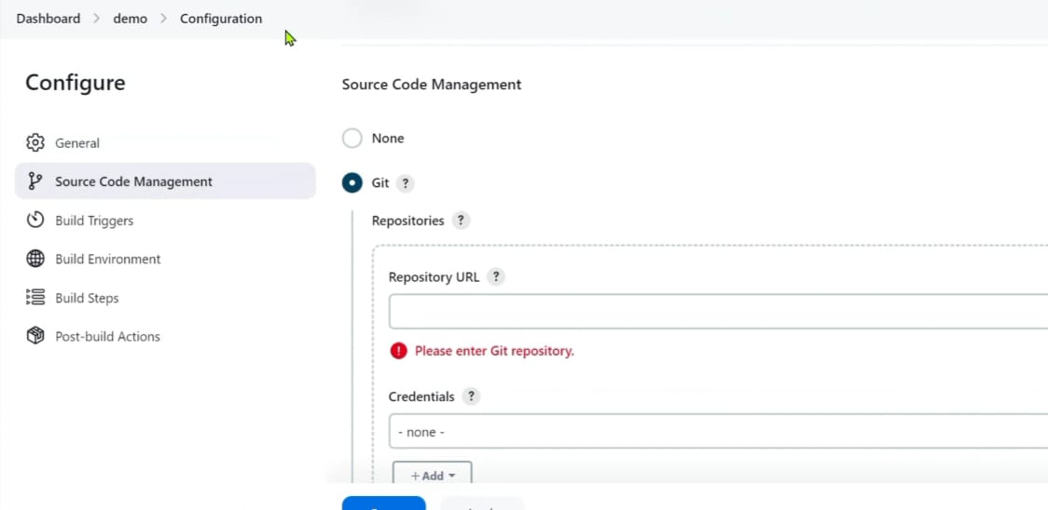
Configure Jenkins:
1. Access Jenkins dashboard.
2. Configure project details.
3. Save and apply changes.

Slide 6
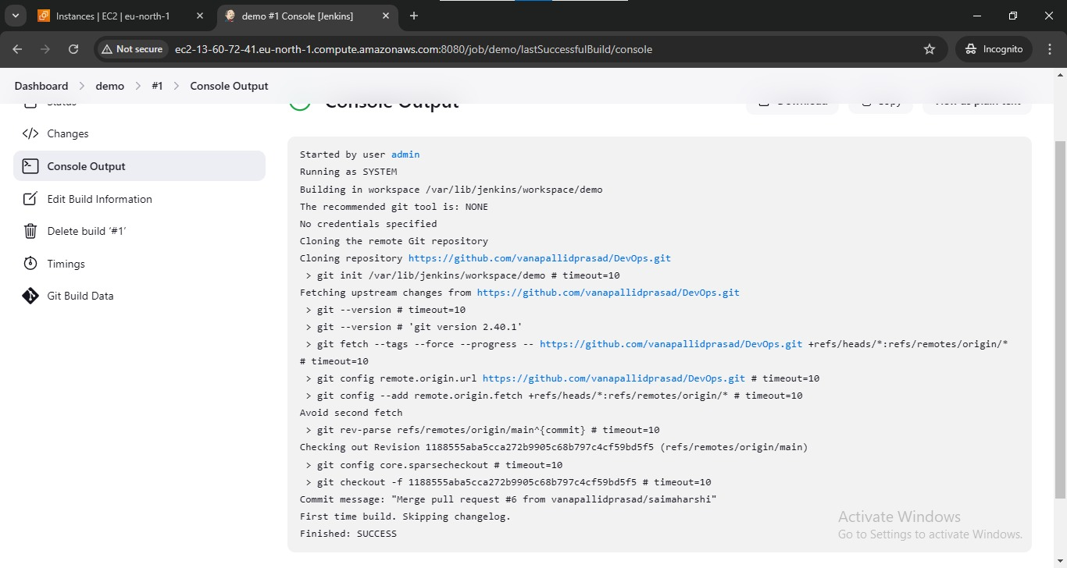
Build and Verify:
1. Trigger a build manually
2. Check the dashboard for build status.
3. Review console output for build details.
4. Review Console output

Slide 7

Thank You

